Slide 1
Computational Thermal Engineering
Stability analysis and Introduction to C language
DAY 4
Kumaresh Selvakumar

Slide 2
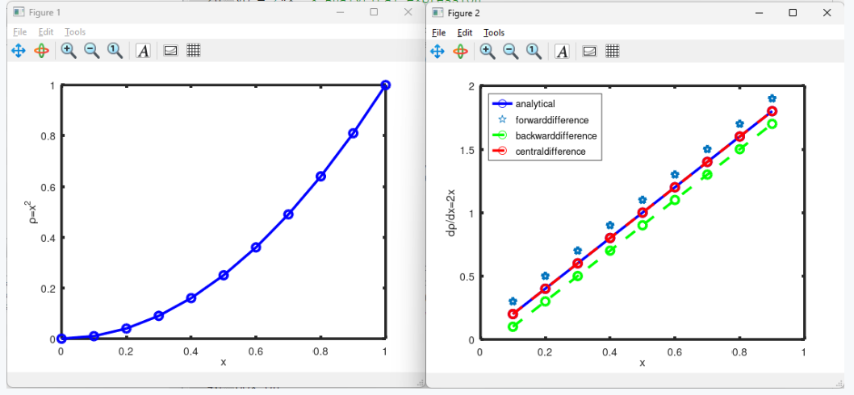
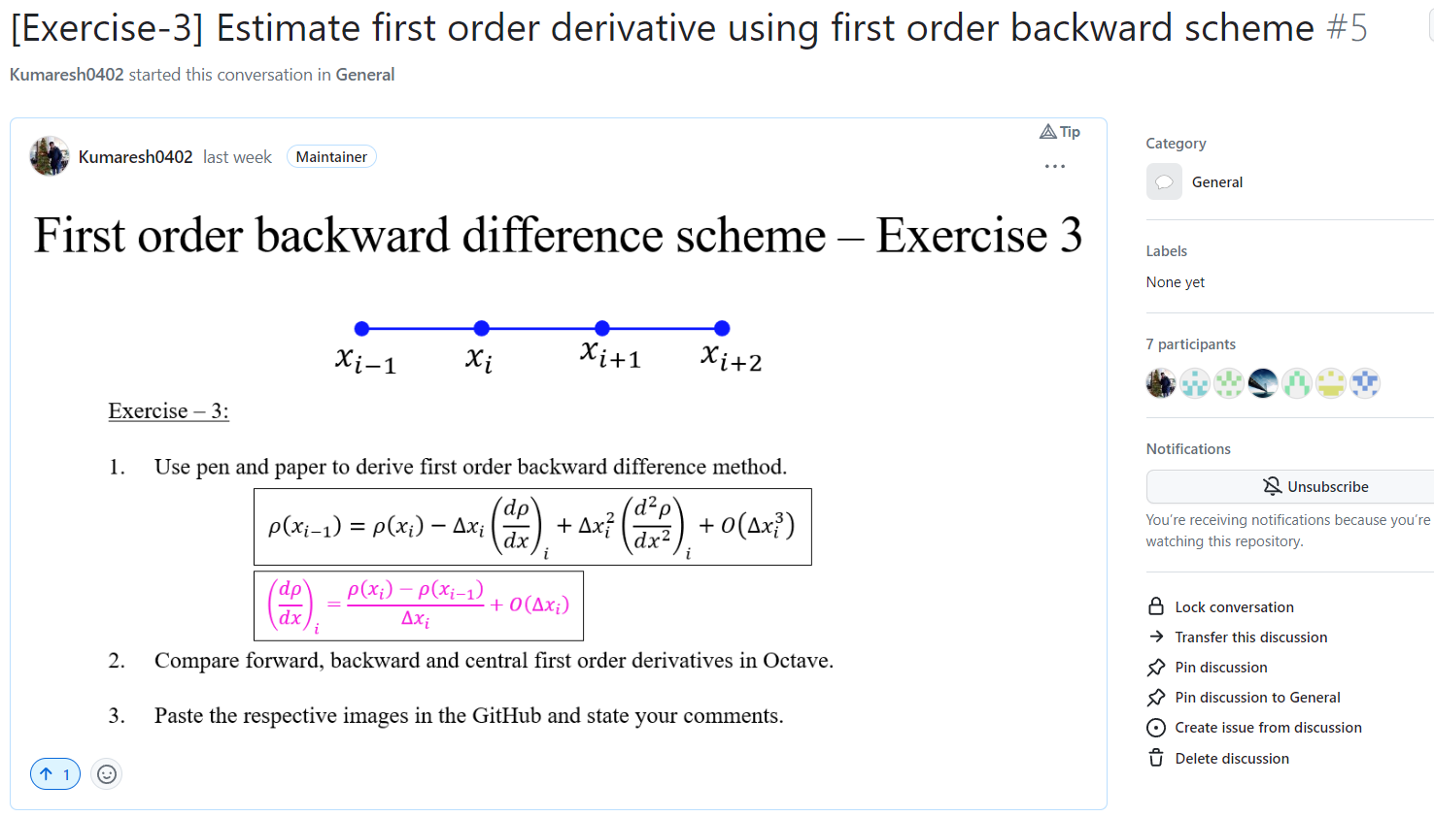
Quick Recap

Slide 3
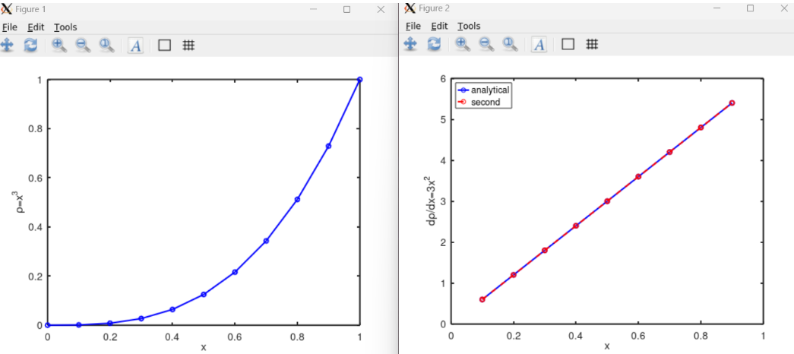
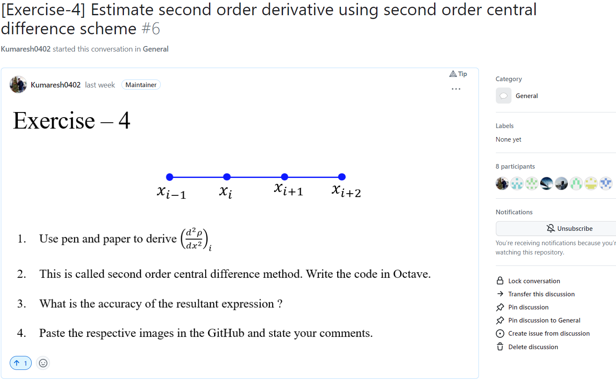
Quick Recap

Slide 4
Contents
Numerical stability
Advection equation
Exercise – 5 (i) and (ii)
Install VS code
Clone the working directory from GitHub
Introduction to C++ for OpenFOAM

Slide 5
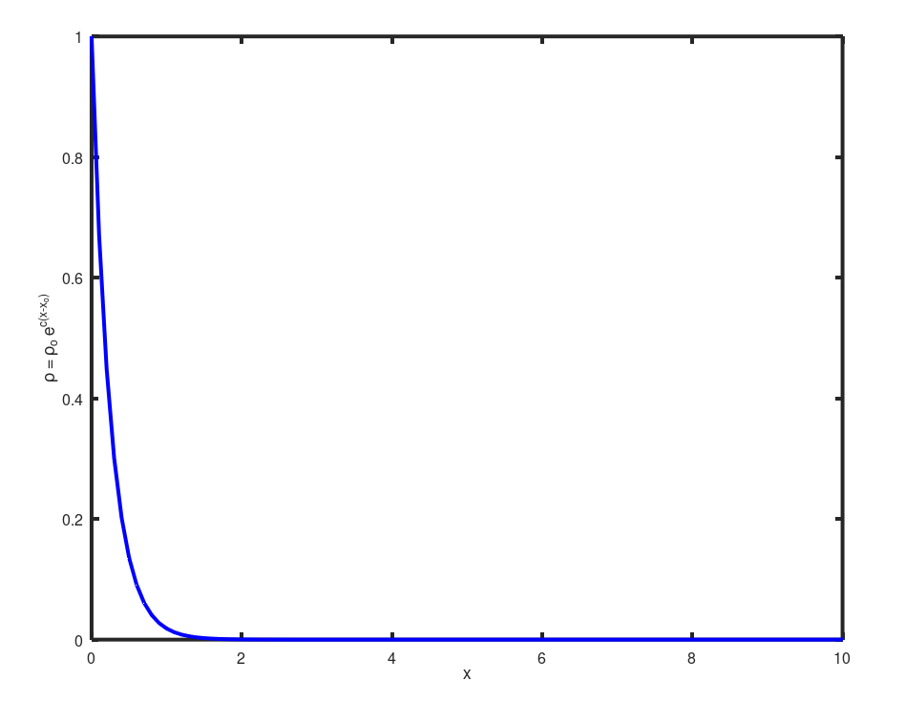
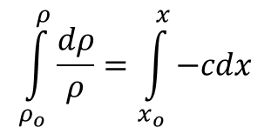
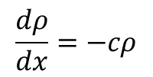
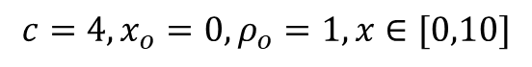
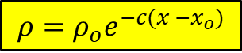
Numerical Stability
Numerical approach should not magnify the error that appears in the solution.
$$\frac{dρ}{dx}=−cρ$$
$$\int_{ρ_{o}}^{ρ}{\frac{dρ}{ρ}}=\int_{x_{o}}^{x}{−cdx}$$
Analytical
$$ρ=ρ_{o}e^{−c(x −x_{o})}$$
$$c=4, x_{o}=0, ρ_{o}=1, x∈[0,10]$$

Slide 6
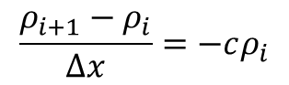
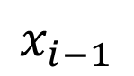
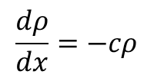
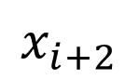
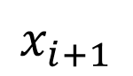
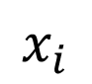
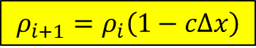
Numerical Stability
Numerical discretization
$$\frac{dρ}{dx}=−cρ$$
$$x_{i−1}$$
$$x_{i}$$
$$x_{i+1}$$
$$x_{i+2}$$
$$\frac{ρ_{i+1}−ρ_{i}}{Δx}=−cρ_{i}$$
Numerical
$$ρ_{i+1}=ρ_{i}\left(1−cΔx\right)$$

Slide 7
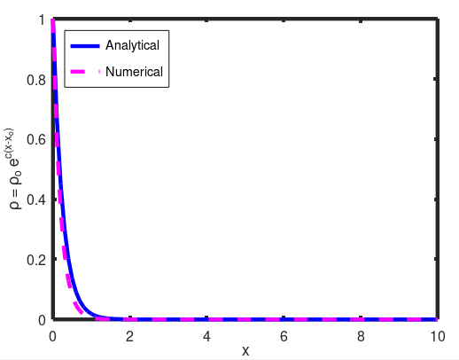
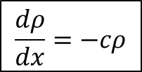
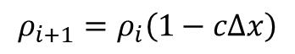
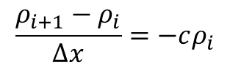
Numerical Stability
Numerical discretization
$$x_{i−1}$$
$$x_{i}$$
$$x_{i+1}$$
$$x_{i+2}$$
$$\frac{dρ}{dx}=−cρ$$
$$\frac{ρ_{i+1}−ρ_{i}}{Δx}=−cρ_{i}$$
$$ρ_{i+1}=ρ_{i}\left(1−cΔx\right)$$
$$c=4, x_{o}=0, ρ_{o}=1, x∈\left[0,10\right], Δx=0.1$$

Slide 8
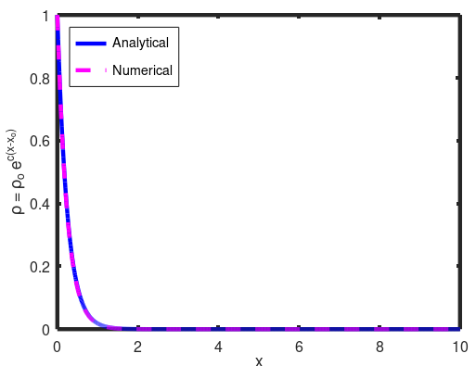
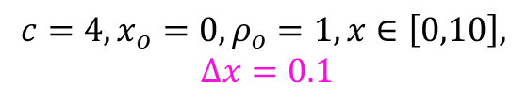
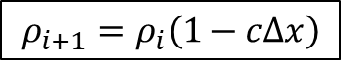
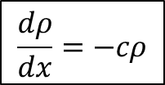
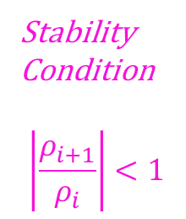
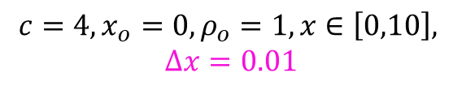
Numerical Stability
$$x_{i−1}$$
$$x_{i}$$
$$x_{i+1}$$
$$x_{i+2}$$
$$\frac{dρ}{dx}=−cρ$$
$$ρ_{i+1}=ρ_{i}\left(1−cΔx\right)$$
Stability
Condition
$$\left|\frac{ρ_{i+1}}{ρ_{i}}\right|<1$$
$$c=4, x_{o}=0, ρ_{o}=1, x∈\left[0,10\right],$$
$$Δx=0.1$$
$$c=4, x_{o}=0, ρ_{o}=1, x∈\left[0,10\right],$$
$$Δx=0.01$$

Slide 9
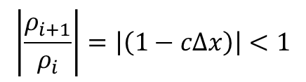
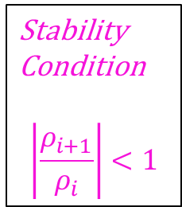
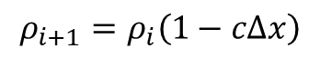
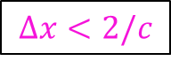
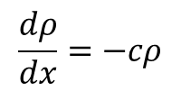
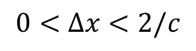
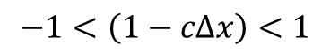
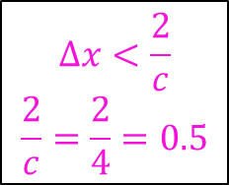
Numerical Stability
Stability
Condition
$$\left|\frac{ρ_{i+1}}{ρ_{i}}\right|<1$$
$$\frac{dρ}{dx}=−cρ$$
$$x_{i−1}$$
$$x_{i}$$
$$x_{i+1}$$
$$x_{i+2}$$
$$ρ_{i+1}=ρ_{i}\left(1−cΔx\right)$$
$$\left|\frac{ρ_{i+1}}{ρ_{i}}\right|=\left|\left(1−cΔx\right)\right|<1$$
$$−1<\left(1−cΔx\right)<1$$
$$0<Δx<2/c$$
$$Δx<\frac{2}{c}$$
$$\frac{2}{c}=\frac{2}{4}=0.5$$
$$Δx<2/c$$

Slide 10
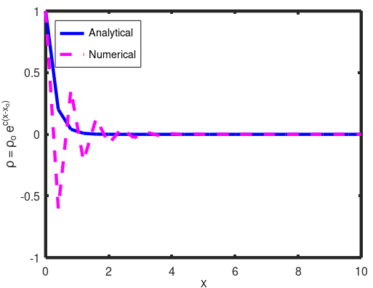
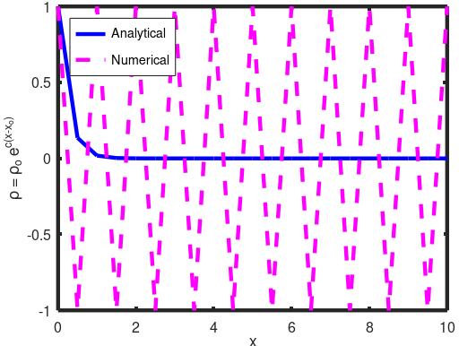
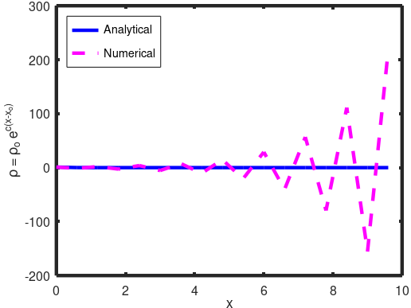
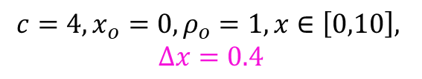
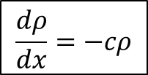
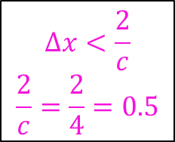
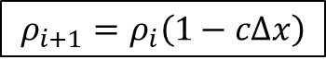
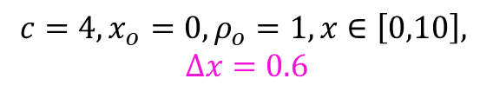
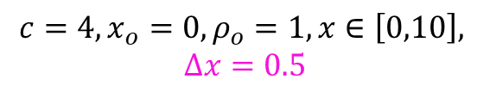
Numerical Stability
$$Δx<\frac{2}{c}$$
$$\frac{2}{c}=\frac{2}{4}=0.5$$
$$x_{i−1}$$
$$x_{i}$$
$$x_{i+1}$$
$$x_{i+2}$$
$$\frac{dρ}{dx}=−cρ$$
$$ρ_{i+1}=ρ_{i}\left(1−cΔx\right)$$
$$c=4, x_{o}=0, ρ_{o}=1, x∈\left[0,10\right],$$
$$Δx=0.4$$
$$c=4, x_{o}=0, ρ_{o}=1, x∈\left[0,10\right],$$
$$Δx=0.5$$
$$c=4, x_{o}=0, ρ_{o}=1, x∈\left[0,10\right],$$
$$Δx=0.6$$

Slide 12
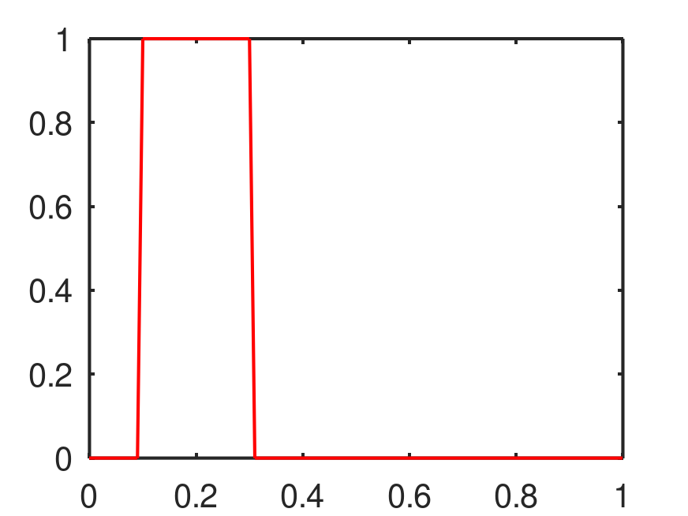
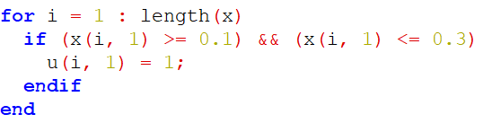
Numerical Stability - Advection equation

Slide 13
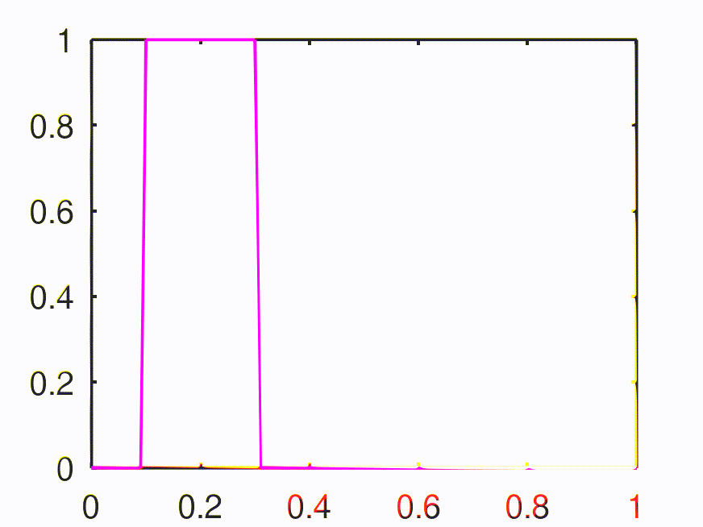
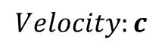
Numerical Stability - Advection equation
$$Velocity:c$$

Slide 14
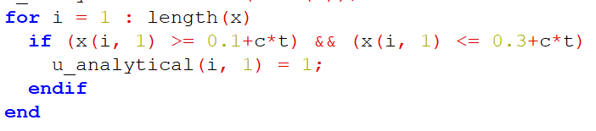
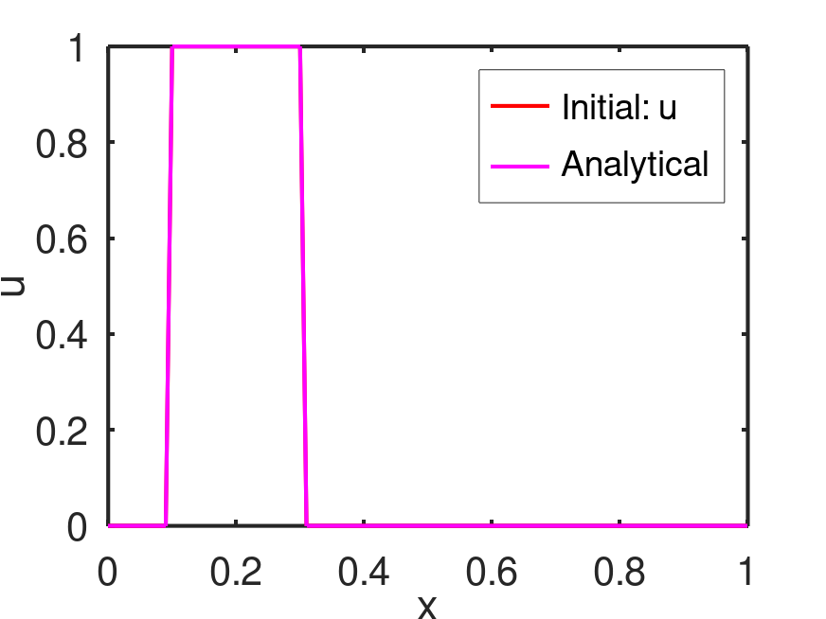
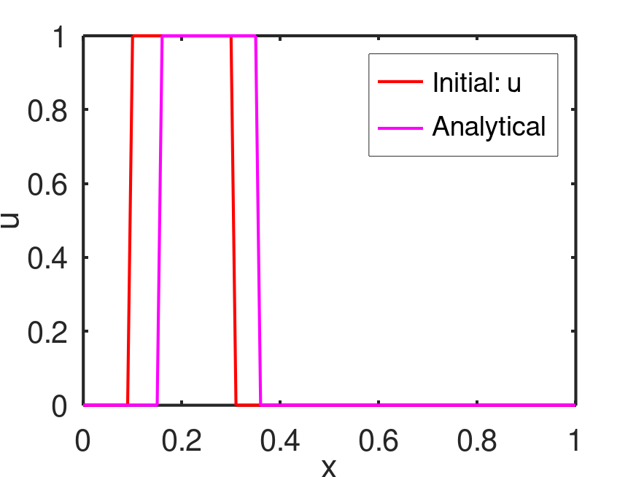


Numerical Stability - Advection equation
$$\frac{∂u}{∂t}+c\frac{∂u}{∂x}=0$$
Advection equation

Slide 15

Numerical Stability - Advection equation

Slide 16

Exercise – 5 (i)
$$x_{i−1}$$
$$x_{i}$$
$$x_{i+1}$$
$$x_{i+2}$$
Solve the following advection equation analytically in octave
Upload in GitHub
$$\frac{∂u}{∂t}+c\frac{∂u}{∂x}=0$$

Slide 17






Numerical Stability - Advection equation
$$\frac{∂u}{∂t}+c\frac{∂u}{∂x}=0$$
$$\frac{u_{i}^{n+1}−u_{i}^{n}}{Δt}+c{\left(\frac{∂u}{∂x}\right)}_{i}^{n}=0$$
$$x_{i−1}$$
$$x_{i}$$
$$x_{i+1}$$
$$x_{i+2}$$
$${\left(\frac{∂u}{∂x}\right)}_{i}^{n}≈\frac{u_{i+1}^{n}−u_{i}^{n}}{Δx_{i}}$$
Simple forward
difference scheme
$$u_{i}^{n+1}=u_{i}^{n}−cΔt{\left(\frac{∂u}{∂x}\right)}_{i}^{n}$$
$${\left(\frac{∂u}{∂x}\right)}_{i}^{n}≈\frac{u_{i+1}^{n}−u_{i−1}^{n}}{2Δx_{i}}$$
Central difference
(Explicit) First order - Forward Euler
(only one unknown (n+1) with other knowns at n^{th} node) → conditionally stable

Slide 18










Numerical Stability - Advection equation
Time level: $n+1$
$$x_{i−1}$$
$$x_{i}$$
$$x_{i+1}$$
$$x_{i+2}$$
Time level: $n$
$$x_{i+1}$$
$$x_{i+2}$$
$$x_{i−1}$$
$$x_{i}$$
Information from right to left end
$${\left(\frac{∂u}{∂x}\right)}_{i}^{n}≈\frac{u_{i+1}^{n}−u_{i}^{n}}{Δx_{i}}$$
Simple forward
difference scheme
$$u_{i}^{n+1}=u_{i}^{n}−cΔt{\left(\frac{∂u}{∂x}\right)}_{i}^{n}$$
$${\left(\frac{∂u}{∂x}\right)}_{i}^{n}≈\frac{u_{i+1}^{n}−u_{i−1}^{n}}{2Δx_{i}}$$
Central difference
Notes:
Consider example of u_i = 1, u_{i+1}=0 and give numerical demo to obtain u_i^{n+1}.
Consider example of u_i=0, u_{i+1}=1

Slide 19




Application: Differential equation used in physics, weather forecasting, stoke markets behaviors (based on probability, past and present information and predicting future information)
Numerical Stability - Advection equation
Time level: $n+1$
$$x_{i−1}$$
$$x_{i}$$
$$x_{i+1}$$
$$x_{i+2}$$
Time level: $n$
$$x_{i+1}$$
$$x_{i+2}$$
$$x_{i−1}$$
$$x_{i}$$
Information from left and right ends
$${\left(\frac{∂u}{∂x}\right)}_{i}^{n}≈\frac{u_{i+1}^{n}−u_{i}^{n}}{Δx_{i}}$$
Simple forward
difference scheme
$$u_{i}^{n+1}=u_{i}^{n}−cΔt{\left(\frac{∂u}{∂x}\right)}_{i}^{n}$$
$${\left(\frac{∂u}{∂x}\right)}_{i}^{n}≈\frac{u_{i+1}^{n}−u_{i−1}^{n}}{2Δx_{i}}$$
Central difference
Notes:
Consider example of u_i = 1, u_{i+1}=0, u_{i-1}=1 and give numerical demo to obtain u_i^{n+1}.
Consider example of u_i = 0, u_{i+1}=1, u_{i-1}=0 and give numerical demo to obtain u_i^{n+1}.

Slide 20




Numerical Stability - Advection equation
Time level: $n+1$
$$x_{i−1}$$
$$x_{i}$$
$$x_{i+1}$$
$$x_{i+2}$$
Time level: $n$
$$x_{i+1}$$
$$x_{i+2}$$
$$x_{i−1}$$
$$x_{i}$$
Information from left to right end
Wind is flowing from left end (bird moves from left to right)
$$u_{i}^{n+1}=u_{i}^{n}−cΔt{\left(\frac{∂u}{∂x}\right)}_{i}^{n}$$
$${\left(\frac{∂u}{∂x}\right)}_{i}^{n}≈\frac{u_{i}^{n}−u_{i−1}^{n}}{Δx_{i}}$$
Simple backward
difference scheme
Notes:
Consider example of u_i = 1, u_{i+1}=0, u_{i-1}=1 and give numerical demo to obtain u_i^{n+1}.
Consider example of u_i=0, u_{i+1}=0, u_{i-1}=1
Mention this scheme depends on the sign of “c”

Slide 21







Numerical Stability - Advection equation
$$\frac{∂u}{∂t}+c\frac{∂u}{∂x}=0$$
$$u_{i}^{n+1}=u_{i}^{n}−cΔt{\left(\frac{∂u}{∂x}\right)}_{i}^{n}$$
$${\left(\frac{∂u}{∂x}\right)}_{i}^{n}≈\frac{u_{i}^{n}−u_{i−1}^{n}}{Δx_{i}}$$
Simple backward
difference scheme
Upwind scheme
(Point 1)
(Point 2)
(Point 3)
(Point 4)
Information from left to right end
Wind is flowing from left end (Flowing towards the source of the wind)
$$u_{i}^{n+1}=u_{i}^{n}−cΔt{\left(\frac{∂u}{∂x}\right)}_{i}^{n}$$
$${\left(\frac{∂u}{∂x}\right)}_{i}^{n}≈\frac{u_{i+1}^{n}−u_{i}^{n}}{Δx_{i}}$$
Simple forward
difference scheme
$$CFL: \frac{cΔt}{Δx}$$
CFL = 0.1
Courant - Friedrichs - Lewy Number
Downwind scheme
Wind is flowing from right end (Flowing away from the source of wind)
Notes:
High CFL

Slide 22







Numerical Stability - Advection equation
$$u_{i}^{n+1}=u_{i}^{n}−cΔt{\left(\frac{∂u}{∂x}\right)}_{i}^{n}$$
$${\left(\frac{∂u}{∂x}\right)}_{i}^{n}≈\frac{u_{i}^{n}−u_{i−1}^{n}}{Δx_{i}}$$
Simple backward
difference scheme
Upwind scheme
$$CFL: \frac{cΔt}{Δx}$$
CFL = 1.5
$$Δt$$
increase
Notes:
High CFL

Slide 23




What did we discuss ?
Proper discrete approximations need to be chosen based on the velocity field.
CFL number is critical to ensure numerical stability.
Upwind scheme
$$u_{i}^{n+1}=u_{i}^{n}−cΔt{\left(\frac{∂u}{∂x}\right)}_{i}^{n}$$
$${\left(\frac{∂u}{∂x}\right)}_{i}^{n}≈\frac{u_{i}^{n}−u_{i−1}^{n}}{Δx_{i}}$$
Simple backward
difference scheme
Downwind scheme
$$u_{i}^{n+1}=u_{i}^{n}−cΔt{\left(\frac{∂u}{∂x}\right)}_{i}^{n}$$
$${\left(\frac{∂u}{∂x}\right)}_{i}^{n}≈\frac{u_{i+1}^{n}−u_{i}^{n}}{Δx_{i}}$$
Simple forward
difference scheme

Slide 24

Exercise – 5 (ii)
$$x_{i−1}$$
$$x_{i}$$
$$x_{i+1}$$
$$x_{i+2}$$
Solve the following advection equation numerically in octave
Central difference with CFL = 0.1 (dx = 0.01, c = 0.01, dt = 0.1, t_final = 5)
Upwind scheme (backward difference) with CFL = 0.1 (dx = 0.01, dt = 0.1, t_final = 5). Change the ”c” value between 0.01 and -0.01 and analyze the stability. Hint: Upwind scheme with c = -0.01 becomes unstable and act as downwind.
Downwind scheme (forward difference) with CFL = 0.1 (dx = 0.01, dt = 0.1, t_final = 5). Change the ”c” value between 0.01 and -0.01 and analyze the stability. Hint: Downwind scheme with c = -0.01 becomes stable and act as upwind.
Examine CFL numbers. Analyse the upwind scheme with CFL = 0.1, 1.0, and 10. Analyze the stability. (dx = 0.01, c = 0.01, dt = 0.1, t_final = 5)
Upload in GitHub.
$$\frac{∂u}{∂t}+c\frac{∂u}{∂x}=0$$
Notes:
CFL < 1 – Numerically stable (conditionally stable based on the condition imposed by CFL) – EXPLICIT method
CFL > = 1 – Numerically unstable

Slide 25


Install VS code

Slide 26

Install VS code
Write this command in your terminal window

Slide 27




Clone the directory
(1) Create a new directory named “workspace”
(3) If you got the above error, type the following commands in the terminal as follows:
ssh-keygen -t rsa -b 4096
<enter-enter-enter>
cat ~/.ssh/id_rsa.pub
Then copy the entire result from the command (cat ~/.ssh/id_rsa.pub) and paste here by creating New SSH key.
(2) Copy SSH key

Slide 28

After cloned, working directory from GitHub appears

Slide 29


Run VS code

Slide 30


Install C++ packages

Slide 31



Introduction to C++ for OpenFOAM
Type the command
Output file “sample” appeared.

